Slide 1
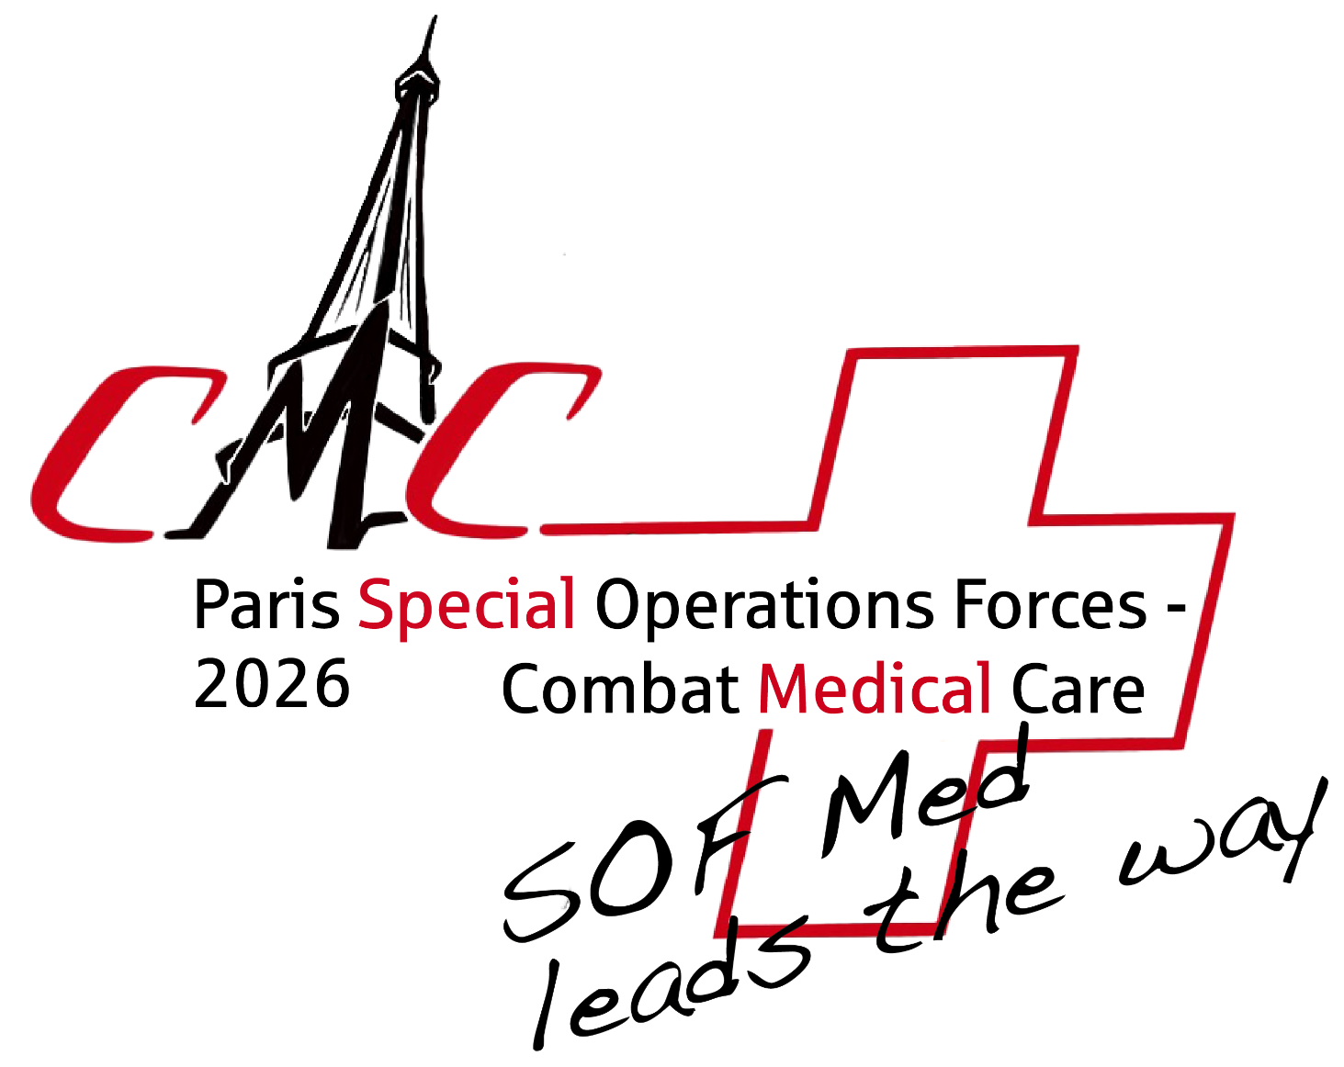

WORKSHOP 8
How do organisations ensure that experience becomes capability, and capability becomes readiness?
Workshop Purpose / Description
How do organisations ensure that experience becomes capability, and capability becomes readiness?
This interactive workshop explores how simulation, operational experience, education, training, and lessons identified can be connected to create meaningful improvements in individual, team, and organisational performance.
Using the Military Circle of Learning as a discussion framework, participants will examine how simulation can support capability development beyond individual skills training, linking education, rehearsal, validation, performance improvement, and lessons exploitation into a continuous learning cycle.
The session draws upon experiences from the STREAM programme (Simulation Training for Resource-poor, Extreme and Austere Medicine), including implementation and evaluation in East Africa and Ukraine. These projects explored how simulation can be used to prepare clinicians and teams for prolonged casualty care, extended evacuation timelines, limited resource availability, and complex decision-making when definitive care is delayed. The workshop will examine how simulation can be used not only to teach clinical interventions, but also to develop the judgement, prioritisation, teamwork, leadership, and adaptability required in contemporary operational environments.
Rather than presenting a prescribed solution, the workshop will use facilitated discussion, practical examples, and shared experience to explore how organisations can build learning systems that adapt, improve, and remain relevant to operational requirements. Participants will be encouraged to share their own experiences, challenges, successes, and lessons identified, creating a collaborative forum for professional discussion and knowledge exchange across the Special Operations community.
What Participants Will Explore
The Military Circle of Learning as a framework for capability development.
How lessons identified can be converted into meaningful learning interventions.
Insights from the STREAM programme and its application in operational and austere environments.
Using simulation to prepare teams for prolonged casualty care and extended patient management.
The role of simulation in developing decision-making, teamwork, leadership, and clinical performance.
Balancing technology with high-value learning.
Creating sustainable approaches to education, training, and readiness across dispersed organisations.
Practical methods for linking operational experience with future training requirements.
What Participants Will Take Away
Participants will leave with:
A practical understanding of how simulation can support capability development across the Military Circle of Learning.
Lessons from the design, delivery, and evaluation of the STREAM programme in East Africa and Ukraine.
Examples of how simulation can be used to prepare personnel and teams for prolonged casualty care challenges.
Ideas and approaches for integrating operational experience, lessons identified, and simulation into existing education and training systems.
Perspectives and shared learning from peers across the Special Operations community.
Practical concepts that can be adapted to strengthen training, readiness, and capability development within their own organisations.
I think this is now much closer to a SOF workshop. It's less about simulation methodology and more about readiness, prolonged casualty care, lessons exploitation, capability development, and learning from operational experience, with STREAM providing the evidence and case studies rather than being the centrepiece.
November 20th
14:00 – 15:30
Room : 103

